Slide 1
Active Directory And Its Security Testing

Slide 2


Project Team
Sankha Subhra Debnath project mentor
Rahul Banik project member

Slide 3
ABSTRACT
Active Directory is a Directory service
developed by Microsoft for Windows domain network. Active Directory Domain provides information about network resource such as users, user’s password, groups authentication process, network printer and computer and makes the information availbael to computer users and administration. Active Directory allows administrator to manage centrally all management with the help of group policy.

Slide 4
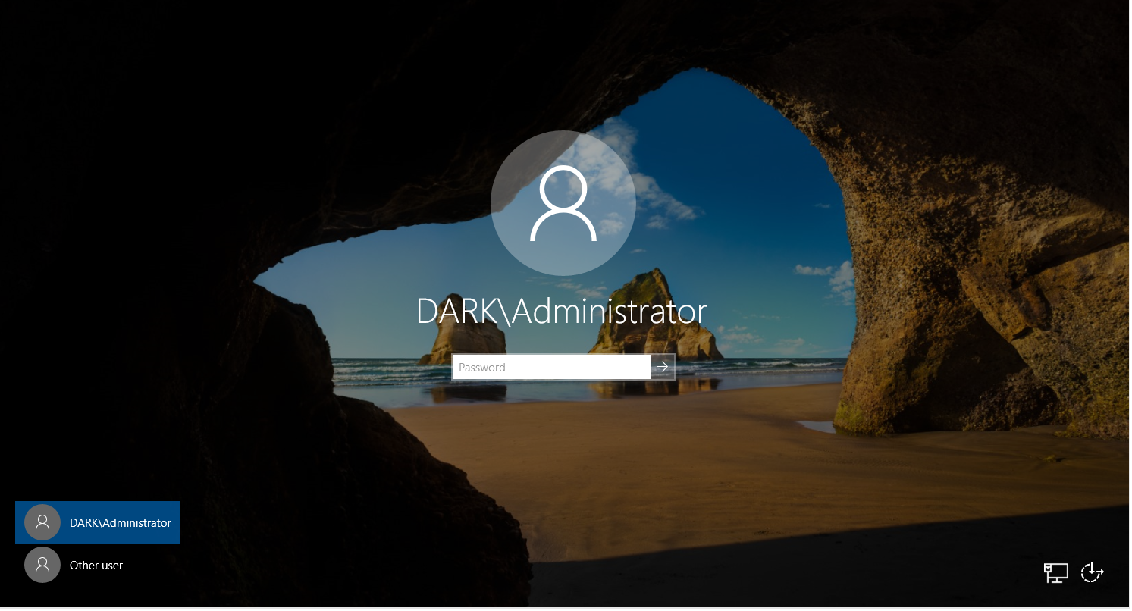
PREREQUISTES
We shell be using Virtualbox as my hypervisor to create the lab but you can choose any hypervisor, the concept is the same.You will need several windows OS Virtual Machines, we are using Microsoft evaluation center to download Windows 10 and Windows Server 2019.
Windows 10 Enterprise
Windows Server 2019
VMware / Virtualbox
Lab Setup
Generation 2 VM
UEFI (Sytem Firmware)
Secure Boot Enable (Secure Boot can only be enable with UEFI)
TPM 2.0 Enable
1(GHz) or faster CPU with 2 or more cores.
4GB Meoory or More
64GB or More of disk space

Slide 5
VAPT
VAPT stands for Vulnerability Assessment & Penetration Testing. It is a security testing to identify security vulnerabilities in an application,network endpoint, and cloud.
The VAPT which helps to infrastructure security which is installed by the banking sector to remain protected from the cyber world threats.
There Are Five Penetration Testing Phases:
Reconnaissance
Scanning
Vulnerability
Assessment
Exploitation
Reporting

Slide 6
Security Group
If you are famillar with windows, you presumably already know that user group may be created so that several users can be assigned access permissions to a single collection of files or other resources.
Domain Admins: Users of this gorup have administrative privileges over the entire domain.
Server Operators: Users in this group can administer Domain Controllers. They cannot change any administrative group memberships.
Account Opeartors: Users in this group can create or modify other accounts in the domain.
Domain Users: Includes all existing user account in the domain.
Domain Computer: Inculdes all existing computers in the domain.

Slide 7
METHODOLOGY
When using Windows domains, all credetntials are stored in the Domain Controllers. Whenver a user tries to authenticate to sever usign doamin credentials,, the server will need to ask the Domain Controller to verify if they are correct. Two protocols can be used for network authentication in Windows doamins.
Kerberos: Userd by any recent version of Windows .This is the default protocol in any recent domain.
NetNTLM : Legacy authentication protocol kept for compatibility purposes.
Authentication:
The client sends an authentication request to the server they want to access.
The server generates a random number and sends it as a challenge to the client.
The client combines their NTLM password hash with the challenge to generate a response to the challenge and sends it back to server to verification.
The server forwards the authentication result to the client

Slide 8
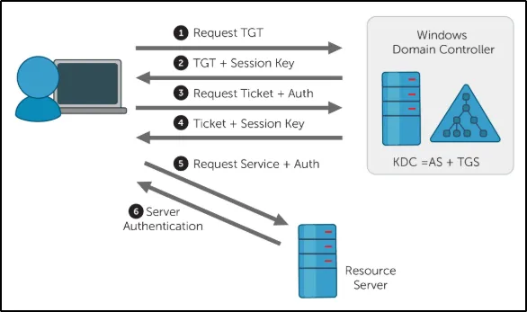
Kerberos Authentication

Slide 9
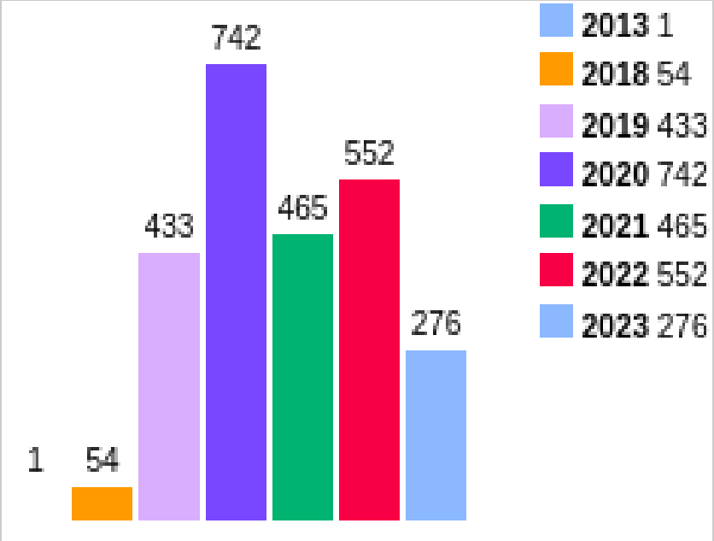
Vulnerabilities of AD Servers
In This Figure shows the exploit vulnerabilities incresing over time form 2013 to 2023, The threat to systems is growng as technology does as well. 276 vulnerabilities have been discovered so far in 2023.

Slide 10
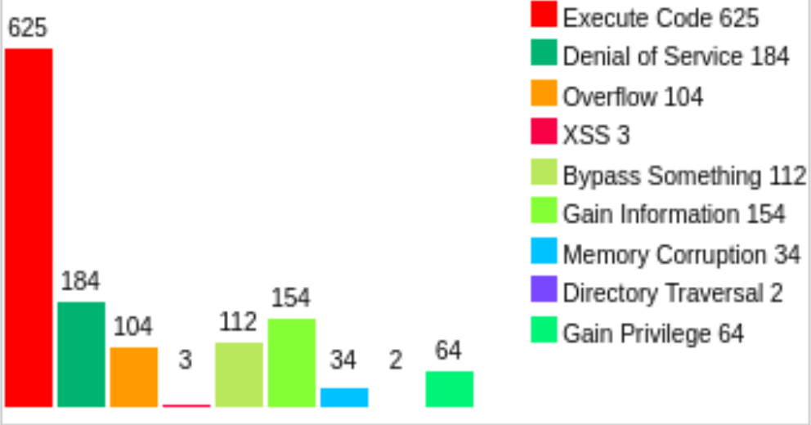
Vulnerabilites Types
In this figure shows the list of vulnerabilites found on Winsows server 2022. The most common vulnerability is found in Code Execution, Denial of Service, Overflow, XSS.and Directory Traversal

Slide 11

Research Paper & References
Active Directory and its security testing.
Active Directory Report.
CVE Details.
Verifications

Slide 12
Active Directory Pentesing Cheatsheet
github:@theUnixe

Slide 13
IMPACT OF AD
Data loss or theft: if an attacker is able to agian access to sensitive data, they may be able to steal it or delete it . This could have a significant impact on the organization, depending on the type of data that is lost or stolen.
Damage to reputaion: if an attacker is able to successfully compromise AD, it could damage the organization’s reputation. This could lead to lost customers, decreased investor confidence, and other negative consequences.

Slide 14
Mitigation of AD
Regularly patching AD and other software. Patches often contain security fixies that can help to product AD from know vulnerabilities.
Using Strong Passwords and multi-factor authentication. Strong passwords and multi-factor authentication can make it more different for attackers to gain access to AD.
Organizations should monitor AD for suspicious activity, such as unauthorized changes to user acounts or permissions.

Slide 15
Thank You

